Slide 1



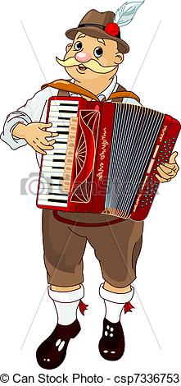
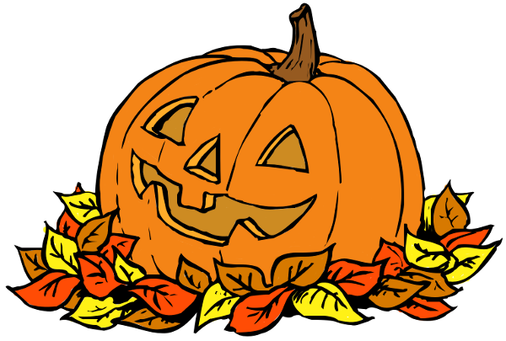
Saturday, October 21st at Chemeketa Park Playground
11:30 a.m. till 1:30 p.m.
This is a family tradition at the Park…Join us!
Bring something to eat and something to share.
The Board will provide grills, plates, adult beverages, and soft drinks, as well as pumpkin decorating!
Pumpkin decorating!
Meet your neighbors
Family Fun!
Music

